Slide 1

How to predict a Heart failure?
Michael eliyahu
Notes:
uiler

Slide 2
In this project, I will present my conclusions about how to predict a heart failure, by using Tools we purchased in the course.

Slide 3
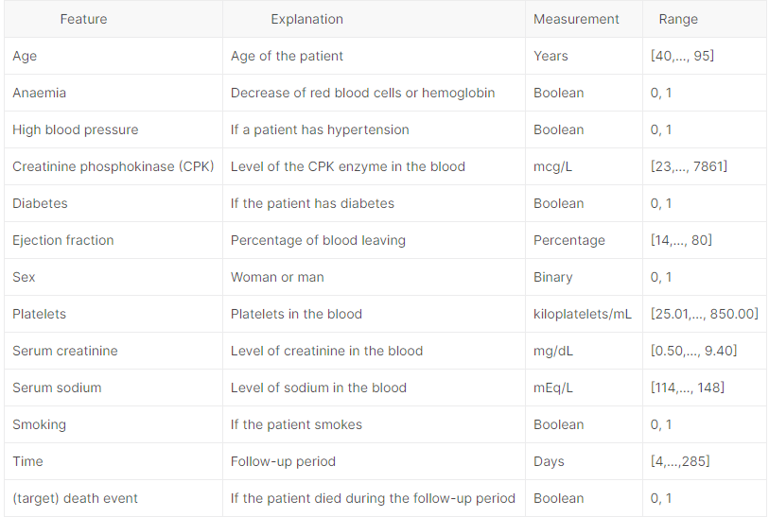
explanation about data that i used in my project

Slide 4
My project is divided into two parts:
Predicting heart failure
Prediction of the most influential factor in heart failure

Slide 5
Predicting heart failure
The five algorithm I choose in dataset analysis are:
Logistic Regression
KNNeighbors
Naive Bayes
Decision Tree
AdaBoost

Slide 6
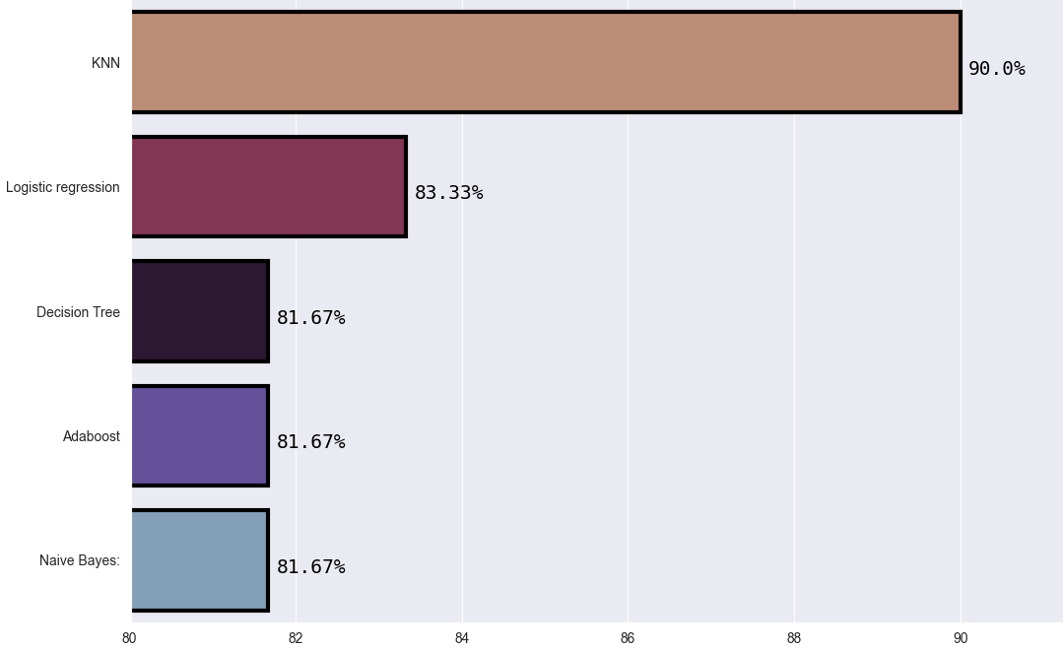
Results:

Slide 7
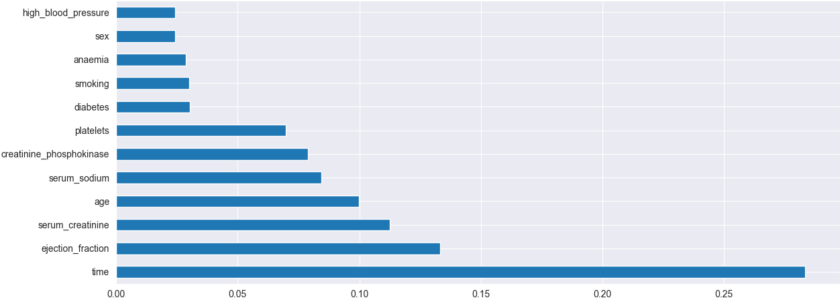
I checked what is the feature importance of predicting the DEATH EVENT,
By using Trees Classifier.
From the graph below, we can see that time, age, serum sodium serum, creatinine and ejection fraction has the most feature importance.

Slide 8
As we can see ejection fraction is one of highest importance of DEATH EVENT.
So, I decided to try predict a high ejection fraction.

Slide 9
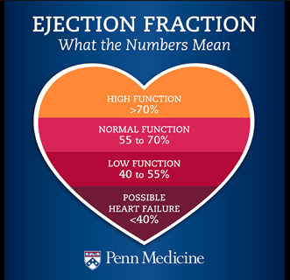
In order to do this, I need to do data processing for ejection fraction.
We can see that in the picture below, less than 40 ejection fraction percent can lead to heart failure.
So I decided that, when is less then 40% is false and above 40% is true.

Slide 10
The five algorithm we choose in dataset analysis are:
Logistic Regression
KNNeighbors
Naive Bayes
Decision Tree
AdaBoost

Slide 11
Results:
Logistic Regression: 76.67
KNneighbors : 73.33
DecisionTree: 56.67
AdaBoost: 75
Naive Bayes: 66.67

Slide 12
Results:
The algorithms with the best result: Logistic Regression - 76.67
The algorithms with the worst result: DecisionTree - 56.67 %

Slide 13
results explanation:
Before I started this project, my big question was about which algorithm to choose.
In my research I came to the conclusion that Decision Tree is the best option.
But from what we just saw, the worst result was Decision Tree and the best is logistic regression
I will try to explain these results

Slide 14
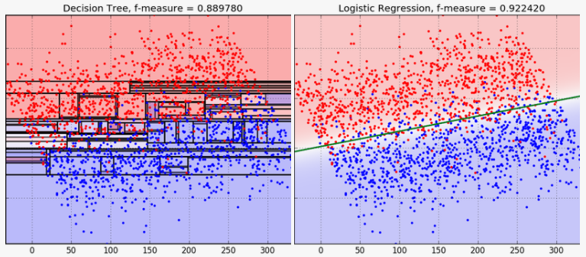
results explanation(2)
Decision Trees bisect the space into smaller and smaller regions, whereas Logistic Regression fits a single line to divide the space exactly into two. when classes are not well-separated, the logistic regression get better result

Slide 15
results explanation(3)
Logistic Regression can give highest importance for determining its class.
We have seen before that the time category gets the most highest importance , so I checked the results of the algorithms without this category.
The gaps between the results of the two algorithms were only two percent, whereas before, the difference was 20 percent

Slide 16
notes:
Data processing was performed on a dataset before use:
The ejection fraction have been replaced by boolean.
Sources:
https://www.kaggle.com/andrewmvd/heart-failure-clinical-data

Slide 17
Question:
From the graph, we can see that time has the most feature importance.
what can i do with this categorie for better results?

